Slide 1
Data Engineering
Assignment 1 – Question 2
Ahmad Murad

Slide 2
Question 2
Provide Similar to Airflow implementation but with csv file is extracted from Postgresql table and the produced JSON file is pushed to MongoDB database. Provide Github repo with all dependencies and detailed README.MD and PPT presentation on how to run your workflow.

Slide 3
Answer Outline
The solution has been built using Docker Containers necessary to manage the pipeline requested in the assignment
The containers build :
Airflow to build the pipeline processing flow, and the main yaml file comes with the below default containers
Webserver
Worker
Schedular
Redis
Init
Postgres SQL ( which is part of the airflow containers)
dpage/pgadmin for Postgres SQL administration
Mongo DB
Mongo DB Express to manage the MongoDB

Slide 4
Answer Outline cont.
The pipeline has been constructed and enhanced to what was requested in order to make it more fun.
The pipeline is built of several PythonOperators , each responsible to do a specific task.
The goal of the pipeline is still the same :
Generate dummy data (I used faker) in a CSV file
Drop the CSV into Postgres database
Extract the data from the Postgres database and save is as CSV
Transform the CSV to a Json format
Dump the Json file into a MongoDB
The first change that I have made is that I have split the step 3 to generate 3 CSV files each holds specific data to a country (Canada , Brazil and Ghana)
The second change is that I have converted the 3 CSV files to 3 Json files and placed each file to the designated collection in the MongoDB.
Lastly I have added one step to check and prepare the database before dropping the Json files

Slide 5
Files uploaded in Github
Docker-compose.yaml
The yaml file have all the configurations to build all the required containers.
Question2.py
Contains the DAG script for the Airflow
Question2.ipynb
Built based on the Question2.py to explain the code used.
This PPT ☺
To present the solution

Slide 6
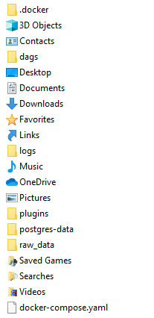
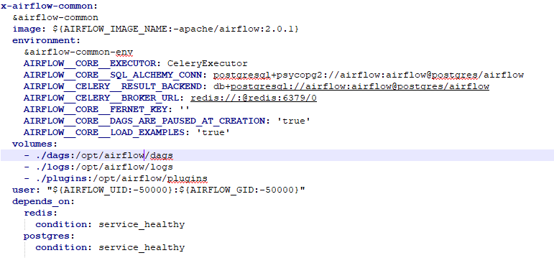
Solution
The files needed to run the solution are :
The docker-compose.yaml file which has all the configuration required to build the containers
The Python Script that defines the DAG , and should be placed in the DAGs folder which is mounted to the

Slide 7
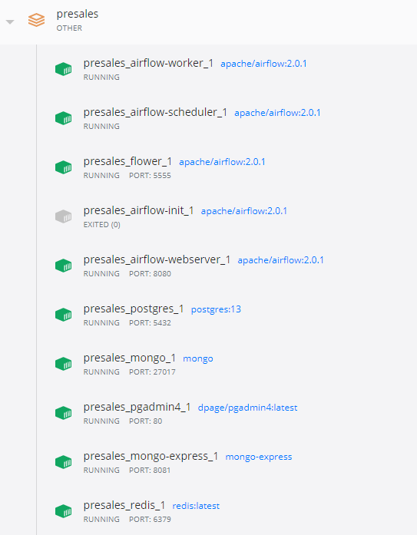
Solution cont.
In the same location where the yaml file is copied run the below command :
docker-compose up
This command will build all the containers
All ports needed has been mounted
All folders needed ( dags, logs , plugin for the airflow ,and Postgres datafiles ) has been mounted.

Slide 8
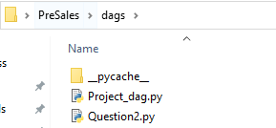
Solution cont.
In the same location where the yaml file is copied run the below command :
docker-compose up
This command will build all the containers
All ports needed has been mounted
All folders needed ( dags, logs , plugin for the airflow ,and Postgres datafiles ) has been mounted.
Copy Question2.py in the dags folder
restart: always

Slide 9
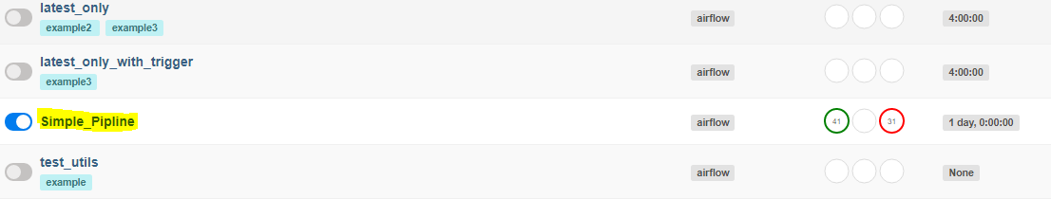
Airflow Pipeline
Access the airflow interface by typing : Localhost:8080 in the web browser
Click on DAGs and you should find the below DAG (Simple_Pipeline) added to the list

Slide 10
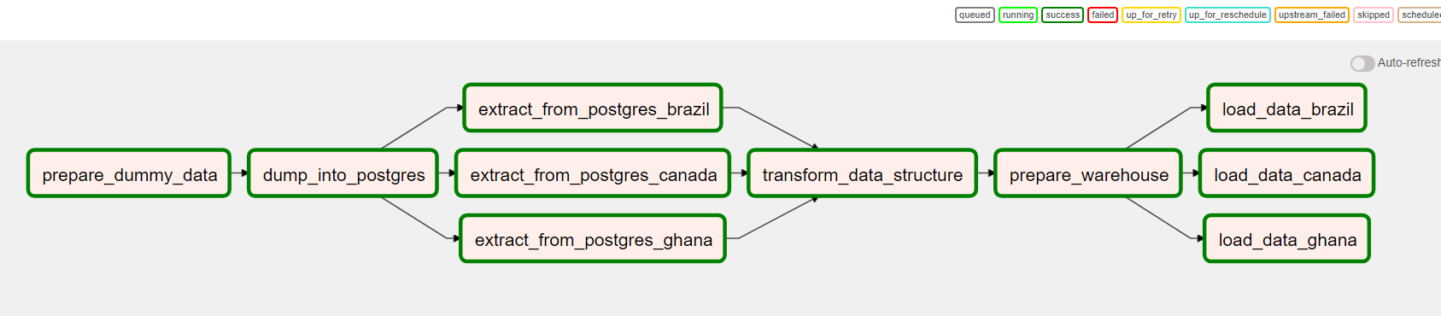
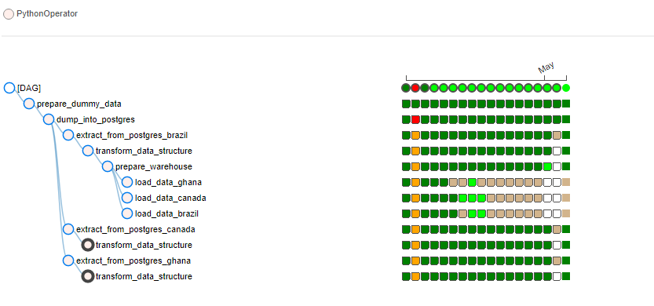
Airflow Pipeline
Click on the Simple_Pipeline DAG and select the graph view
The airflow DAG after building the python script is presented as below

Slide 11
The DAG Code
The DAG code has been documented using Jupyter Notbook
Although the Jyputer note book might through many errors at certain codes , but the Question.py file runs without errors on the airflow environment.

Slide 12
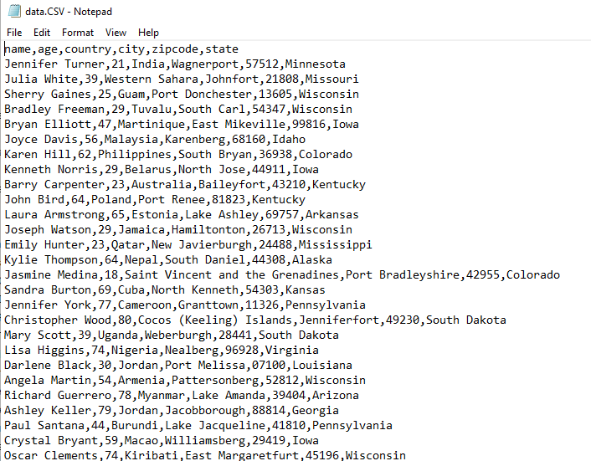
Creating Dummy Data
The first step in the DAG process is PythonOperator that uses Faker to generate the dummy data and dump it on a CSV file called data.CSV and place it on the /opt/airflow/logs folder

Slide 13
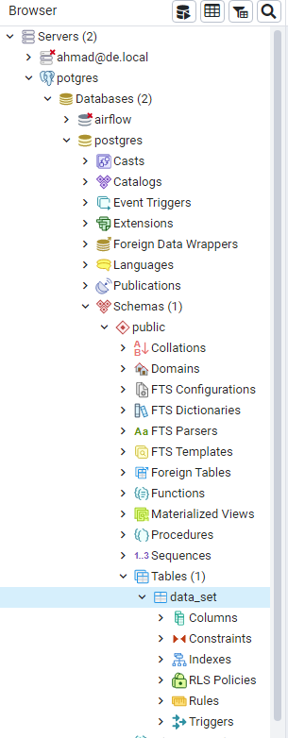
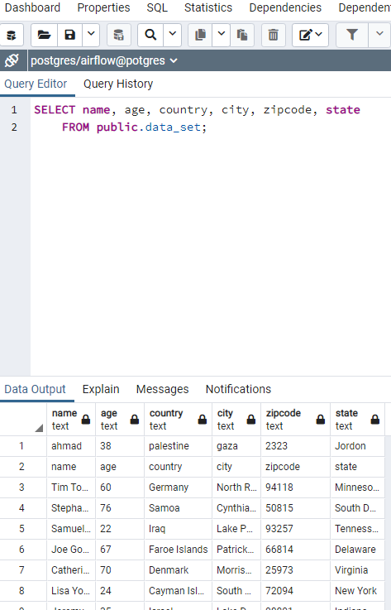
Loading the CSV into Postgres
The next step is to load the CSV file into Postgres DB
The function creates a table called Data_set
Then it loads the data into that table.
The Postgres Database changes the IP Randomly when the container is up , it usually reserve one of the below IPs , but sometimes it change it to 172.18.0.5 ,if the flow failed trying to access the Postgres on once of those IPs , then you will need to change it in this script to point to the right IP.

Slide 14
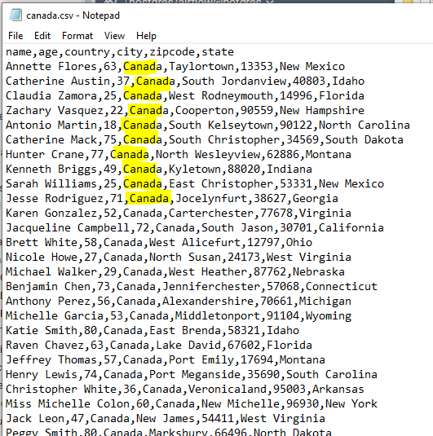
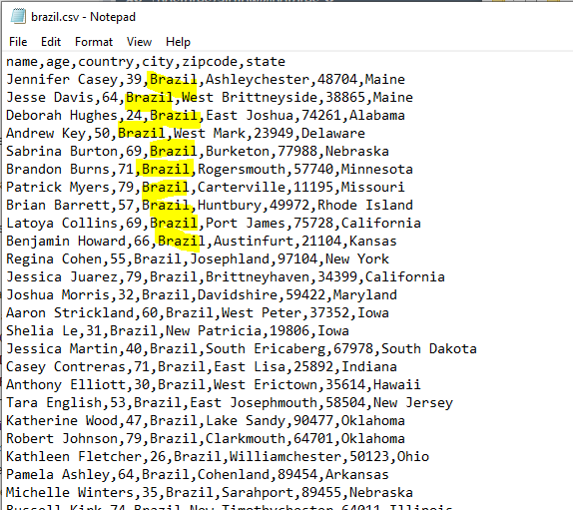
3 Steps for Extracting
Then there are 3 steps in the flow to extract 3 CSV files related, each filtered on a different country , one for Canada , one for Brazil and one for Ghana.
Note that the generated dummy data contains a field called ‘Country’
The resulted 3 files will located on the /opt/airflow/logs

Slide 15
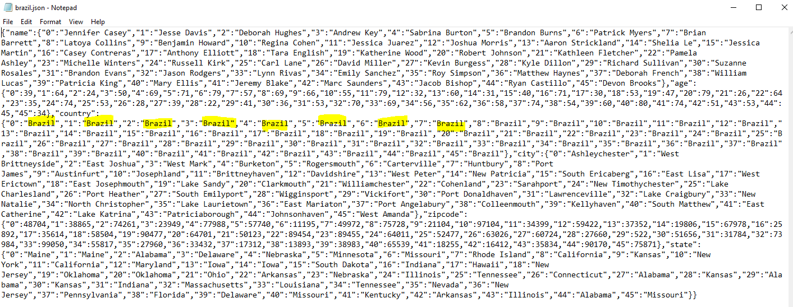
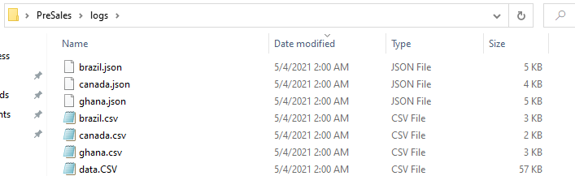
Converting CSV to Json
Using Pandas , this step reads the CSV files
then transform them into Json files and dump them on the location/opt/airflow/logs
After this step , there will be 7 files created , the initial dummy data.csv , 3 CSV files for each country and 3 Json files transformed from the CSV files.

Slide 16
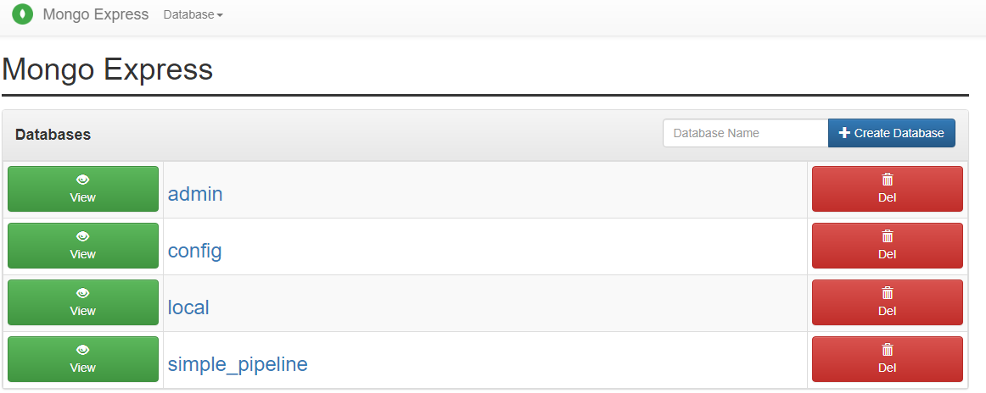
Preparing the MongoDB
In this step the script just connect to the Mongo DB and make sure that the database “Simple_Pipeline” exists or not , and if its not it will create it.

Slide 17
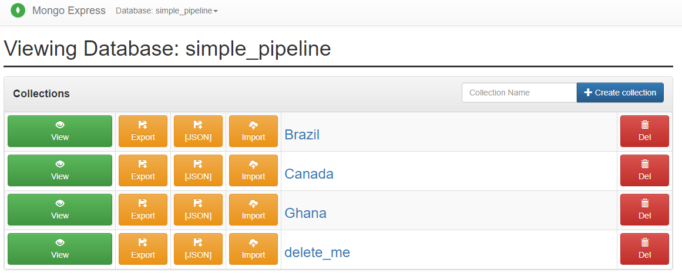
Loading Json files to MongoDB
The last 3 parallel steps are built to load each Json file into MongoDB database (‘Simple_Pipeline’) in the disgnated collection named for each country.

Slide 18
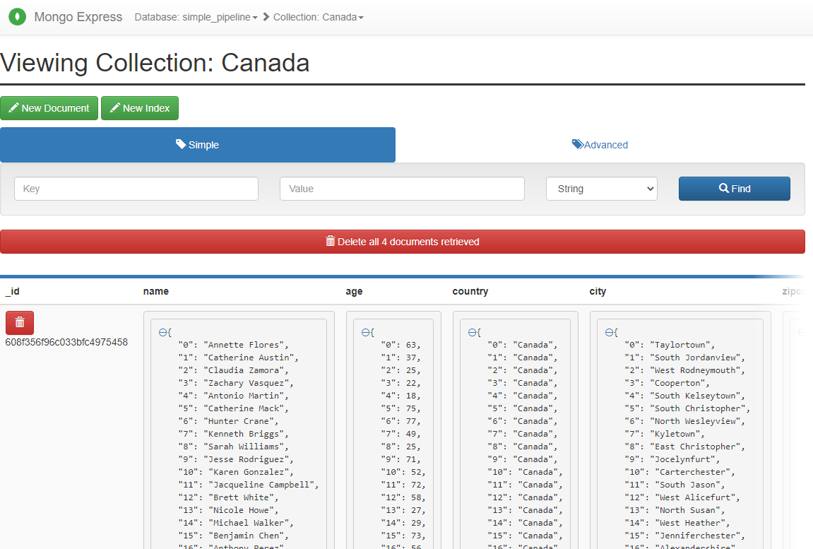
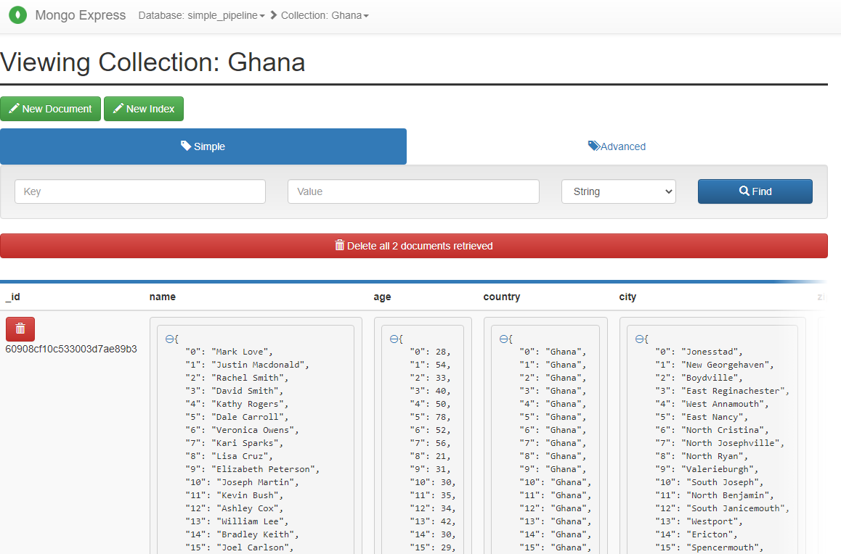
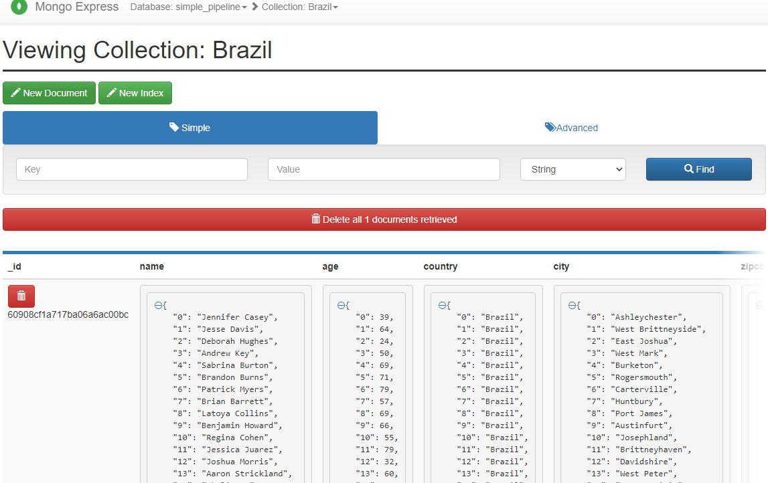
Final Result
All Json document are loaded into the Mongo DB

